Slide 1
TOXICITY DETECTION IN TWEETS TO FIGHT ONLINE ABUSE
CSCI 6708: NATURAL LANGUAGE PROCESSING
Naina Nijher: B00812651
Nirav Solanki: B00808427

Slide 2

OUTLINE
Project Introduction
Motivation
Project Outline
Data Pre-processing and Cleaning
Data Vectorisation and Feature Extraction
Model Fitting and Testing
Tweets Extraction
Conclusion

Slide 3

INTRODUCTION
Aim: To keep a check on cyber abuse by content evaluation of the tweets
Expected Outcome: The tweets will then be categorised into 4 categories depending upon the toxicity level: toxic, OBSCENE, threat, Identity hate
Methodology: Implemented with optimised models of Random Forest Classifier and Naïve Bayes Classifier

Slide 4

MOTIVATION
INCREASE IN INTERNET USAGE
REACH OF THE WEB BEYOND THE BOUNDARIES OF GENDER, ETHNICIYTY, NATIONALITY
MAY LEAD TO HOSTILE FEELINGS IF UNCHECKED
HENCE, THE URGENT NEED TO FILTER TOXIC CONTENT

Slide 5
PROJECT OUTLINE
DATA-PREPROCESSING
DATA CLEANING
FEATURE EXTRACTION
COUNT VECTORISATION
TFIDF TRANSFORMATION
MODELLING AND PREDCTION
STOPWORDS REMOVAL
STEMMING
RANDOM FOREST CLASSIFICATION
MULTINOMIAL NAÏVE BAYES CLASSIFICATION
PREDICTION ON LIVE TWITTER STREAMING DATA
ACCURACY COMPARISON USING CONFUSION MATRIX
TOKENIZATION

Slide 6

DATA PRE-PROCESSING - OBTAINING THE DATASET
THE DATASET WAS OBTAINED FROM KAGGLE AND CONTAINED OVER TEN THOUSAND COMMENTS ALONG WITH THEIR CLASSIFICATION
OBSERVATION: EACH CLASSIFICATION IS DIFFERENT AND INDEPENDENT OF EACH OTHER AND QUITE A FEW COMMENTS WERE CLASSIFIED INTO MORE THAN 1 CATEGORY

Slide 7
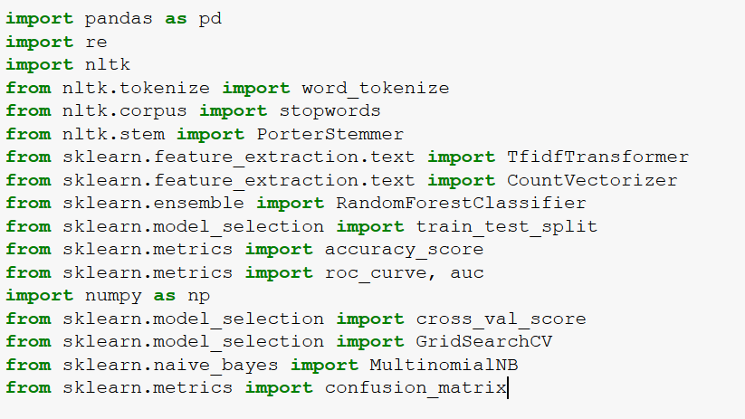
LIBRARIES USED

Slide 8
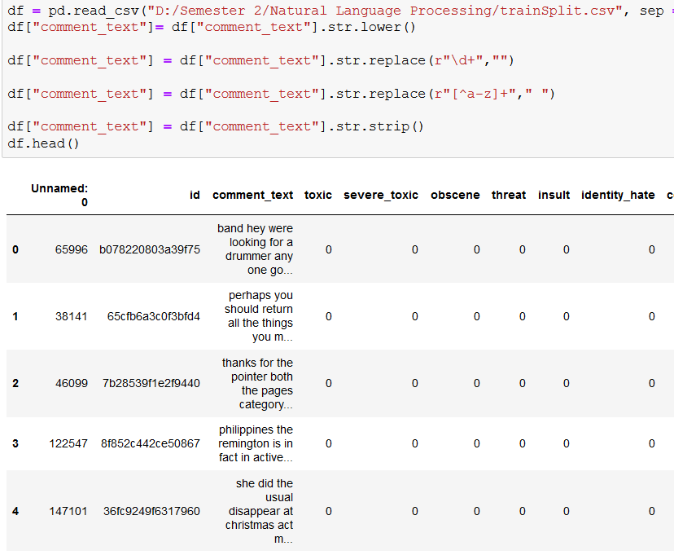
DATA PRE-PROCESSING - DATA CLEANING
LOADED THE DATASET INTO A PANDAS DATAFRAME
THE TEXT WAS CONVERTED INTO LOWERCASE AND ALL THE SPECIAL CHARACTERS WERE REMOVED
ANY EXTRA SPACES WERE REMOVED FROM THE TEXT

Slide 9
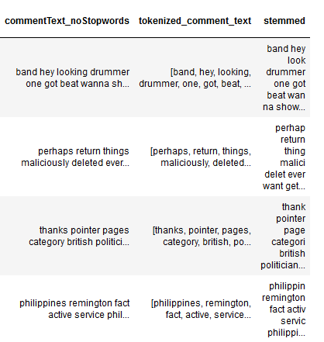
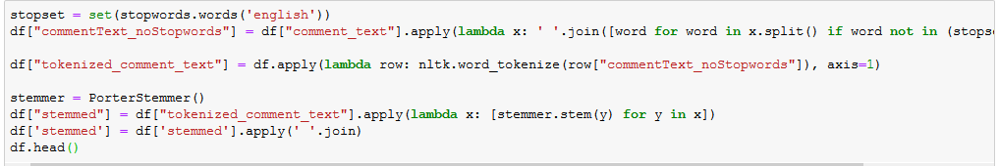
DATA PRE-PROCESSING - DATA CLEANING
ALL THE STOPWORDS FROM THE ENGLISH SET WERE REMOVED
THE TEXT WAS THEN TOKEINZED USING THE WORD_TOKENIZE FUNCTION FROM THE NLTK LIBRARY
ALL THE WORDS WERE THEN STEMMED USING THE PORTER STEMMER LIBRARY

Slide 10
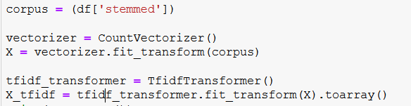
FEATURE EXTRACTION - COUNT VECTORIZATION & TFIDF TRANSFORMATION
THE DATA WAS THEN VECTORIZED USING COUNTVECTORIZER() TO MAP EACH WORD TO A VECTOR VALUE
TO INCREASE THE ACCURACY OF THE MODEL, TFIDF TRANSFORMATION WAS APPLIED TO RETAIN THE MOST FREQUENT OCCURENCES

Slide 11

DATA MODELLING
SELECTED MACHINE LEARNING MODELS FOR THE CHOSEN PROBLEM:
NAÏVE BAYES CLASSIFIER
RANDOM FOREST CLASSIFIER

Slide 12
DATA MODELLING - NAÏVE BAYES CLASSIFIER
THE FEATURE VECTORS REPRESENT THE FREQUENCIES
TO BUILD THE MODEL,
from sklearn.naive_bayes import MultinomialNB
WAS IMPORTED
THE CLASS LABELS ARE TOXIC, OBSCENE, THREAT, IDENTITY HATRED
EACH PROBLEM INSTANCE IS A VECTOR OF THE FEATURE VALUES
THE CLASSIFER CONSIDERS EACH OF THE FEATURES TO BE INDEPENDENT OF EACH OTHER

Slide 13
DATA MODELLING - RANDOM FOREST CLASSIFIER
RFC OPERATES BY CONSTRUCTING MULTI-LEVEL DECISION TREES
USES THE PROCESS OF “FEATURE BAGGING”
PROBLEM FACED: OVERFITTING
SOLUTION: CROSS VALIDATION TO OPTIMISE THE MODEL
TO BUILD THE MODEL,
from sklearn.ensemble import RandomForestClassifier
WAS IMPORTED

Slide 14
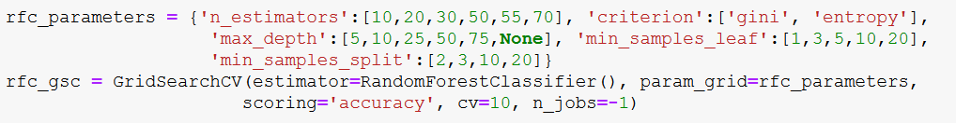
DATA MODELLING - CROSS VALIDATION
TO OPTIMISE THE MODEL, CROSS VALIDATION WAS PERFROMED TO OBTAIN THE BEST PARAMETERS FOR THE MODEL TO GIVE MAXIMUM ACCURACY
BEST PARAMETERS: MAX_DEPTH = 75, N_ESTIMATORS = 20

Slide 15
NAÏVE BAYES CLASSIFIES VS RANDOM FOREST CLASSIFIER
 | NAÏVE BAYES CLASSIFIER WITHOUT SMOOTHENING | RANDOM FOREST CLASSIFIER
Toxic | 0.9233082706766917 | 0.9293233082706767
Threat | 0.9794486215538847 | 0.9974937343358395
Obscene | 0.9493734335839599 | 0.9719298245614035
Identity Hate | 0.9774436090225563 | 0.9939849624060151
Insult | 0.9478696741854636 | 0.9593984962406015

Slide 16





Naïve Bayes Confusion Matrix

Slide 17





Random Forest Tree Confusion Matrix

Slide 18
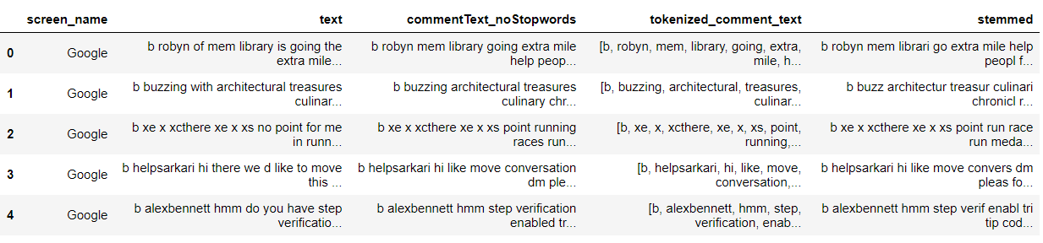
TWEETS EXTRACTION
We used four screen Names : "google", "msdev","rosiebarton","realDonaldTrump"
Stored the data in CSV format and then performed the same preprocessing steps as mentioned above

Slide 19
Future Work
Applying Support Vector Machine algorithm for classification
Applying a deep learning based approach to solve the problem
Similar to twitter, the classification techniques can be applied to content of other social media sites

Slide 20
CONCLUSION
Random Forest tree algorithm provides better accuracy then Naive Bayes on all 4 Categories.
The time to train Random Forest tree model is significantly more then Naive Bayes.
When detecting toxicity in comments, Random Forest tree performed only slightly better then Naive Bayes.
Accuracies of both the models were above 92%.

